Slide 1
Chapter 9
BIS project management

Slide 2
Learning objectives
After this lecture, you will be able to:
  understand the main elements of the project management approach;
  relate the concept of project management to the creation of BIS;
  assess the significance of the different tasks of the project manager;
  outline different techniques for project management.

Slide 3
Management issues
From a managerial perspective, this lecture addresses the following areas:
  What are the success criteria for a BIS project?
  What are the attributes of a successful project manager?
  Which project management activities and techniques should be performed by the project manager for a successful outcome?

Slide 4
Project management
Projects: Projects are unique, one-time operations designed to accomplish a specific set of objectives in a limited timeframe.

Slide 5
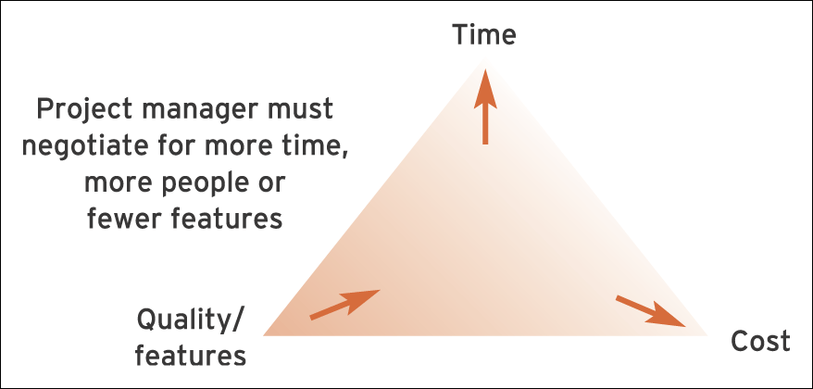
Figure 9.1 Three key elements of project management

Slide 6
Why do projects fail?
Lyytinen and Hirscheim (1987) researched the reasons
for information systems projects failing. They identified five broad areas which still hold true today:
Technical failure stemming from poor technical quality – this is the responsibility of the organisation’s IS function.
Data failure due to (a) poor data design, processing errors and poor data management and (b) poor user procedures and poor data quality control at the input stage. Responsibility for the former lies with the IS function, while that for the latter lies with the end-users themselves.

Slide 7
Why do projects fail? (Continued)
User failure to use the system to its maximum capability – may be due to an unwillingness to train staff or user management failure to allow their staff full involvement in the systems development process.
Organisational failure, where an individual system may work in its own right but fails to meet organisational needs as a whole (e.g. while a system might offer satisfactory operational information, it fails to provide usable management information). This results from the senior management’s failure to align IS to overall organisational needs.
Failure in the business environment – this can stem from systems that are inappropriate to the market environment, failure in IS not being adaptable to a changing business environment (often rapid change occurs), or a system not coping with the volume and speed of the underlying business transactions.

Slide 8
Project organisation
Project sponsor: The project sponsor’s role is to provide a justification of the project to senior management.
Project manager: Appointed by the project sponsor the project manager’s role is to provide day-to-day management and ensure that the project objectives are met.
Project user: The project user is the person or group of people who will be utilising the outcome of the information systems project.
Quality manager: This role involves defining a plan containing procedures that ensure quality targets are met.
Risk manager: All projects contain some risk that the investment made will not achieve the required business objectives.

Slide 9
Project management process
The project management process includes the following main elements:
  Estimate
  Schedule/plan
  Monitoring and control
  Documentation.

Slide 10
Estimation
Estimation: Estimation allows the project manager to plan for the resources required for project execution through establishing the number and size of tasks that need to be completed in the project.

Slide 11
Work breakdown structure (WBS): This is a breakdown of the project or a piece of work into its component parts (tasks).
Project constraints: Projects can be resource-constrained (limited by the type of people, monetary or hardware resources available) or time-constrained (limited by the deadline).

Slide 12
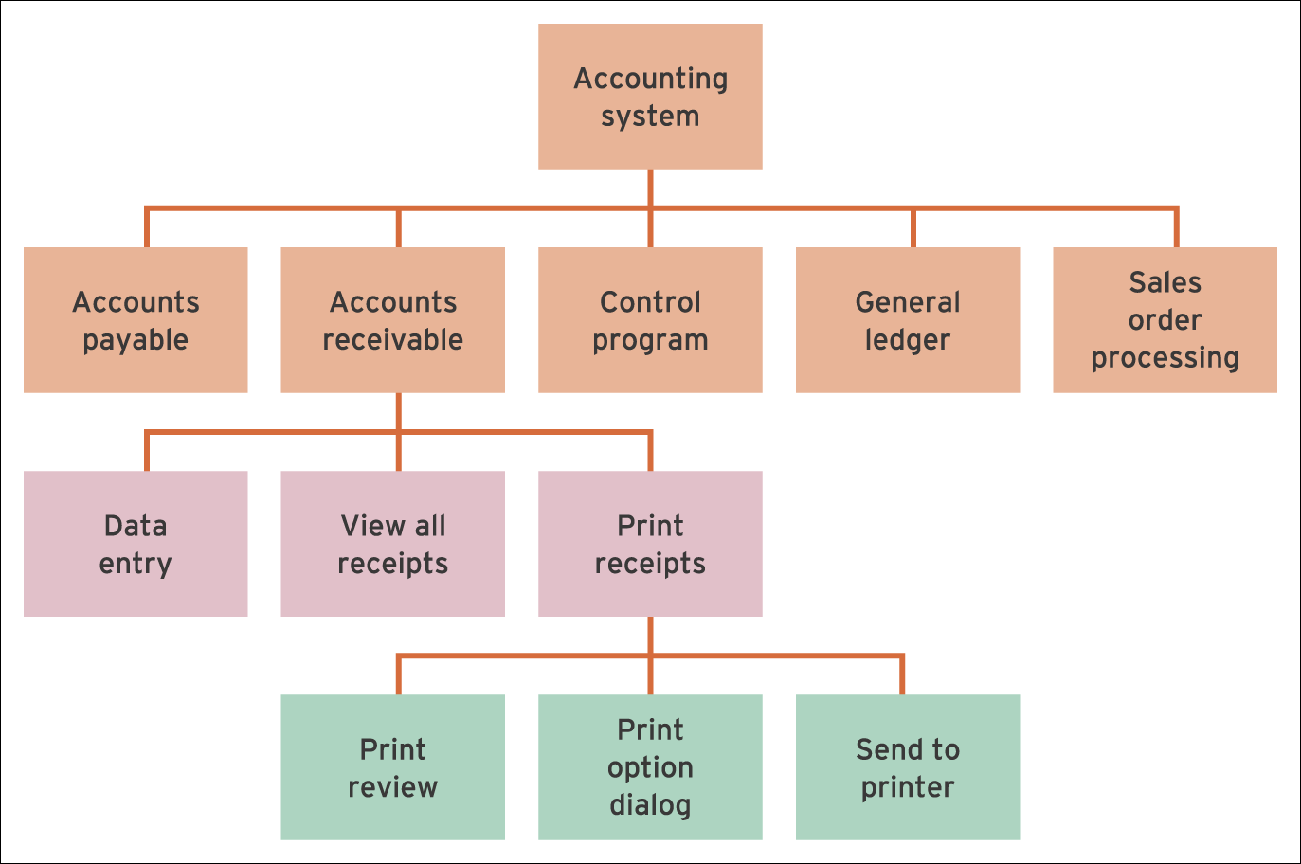
Figure 9.2 Work breakdown structure (WBS) for an accounting system

Slide 13
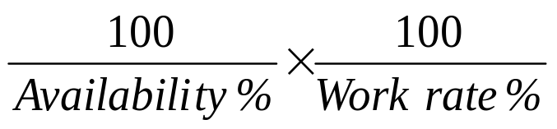
Effort and elapsed time
Elapsed time = Effort time =
Effort time is the total amount of work that needs to occur to complete a task.
The elapsed time indicates how long in time (such
as calendar days) the task will take (duration).

Slide 14
Estimation
Estimate effort time for an average person to undertake the task.
Estimate different work rates and availability of staff.
Allocate resources (staff) to task.
Calculate elapsed time on the basis of the number of staff, availability and work rate.
Schedule tasks in relation to other tasks.

Slide 15

COCOMO
Constructive cost model (COCOMO): A model used to estimate the amount of effort required to complete a project on the basis of the estimated number of lines of program code
  where:
  WM = number of person months
  C = one of three constant values dependent on development mode
  KDSI = delivered source lines of code × 1000
  K = one of three constant values dependent on development mode
  EAF = effort adjustment factor.

Slide 16
Function point analysis
Function point analysis: A method of estimating the time it will take to build a system by counting up the number of functions and data inputs and outputs and then comparing these to completed projects.
The five user function categories are as follows:
  number of external input types;
  number of external output types;
  number of logical internal file types;
  number of external interface file types;
  external enquiry types.

Slide 17
Scheduling
Scheduling: Scheduling involves determining when project activities should be executed.
The finished schedule is termed the project plan.
Resource allocation: This activity involves assigning a resource to each task.

Slide 18
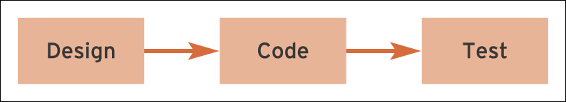
Figure 9.3 Serial relationship of activities

Slide 19
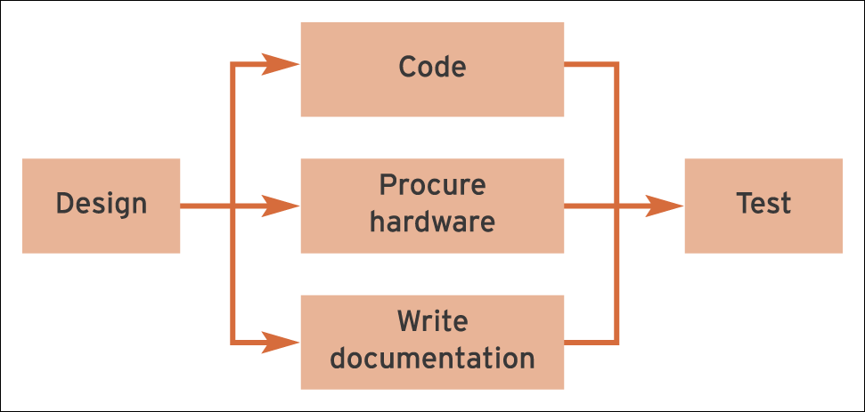
Figure 9.4 Parallel relationship of activities

Slide 20
Monitoring and control
Monitoring and control:
Monitoring involves ensuring the project is working to plan once it is started. Control is taking corrective action if the project deviates from the plan.

Slide 21
PRINCE2
PRINCE2: A process-based project management methodology for effective IS project.
The PRINCE2 methodology says that a project should have the following:
  An organised and controlled start, i.e. organise and plan things properly before leaping in
  An organised and controlled middle, i.e. when the project has started, make sure it continues to be organised and controlled
  An organised and controlled end, i.e. when you’ve got what you want and the project has finished, tidy up the loose ends.

Slide 22
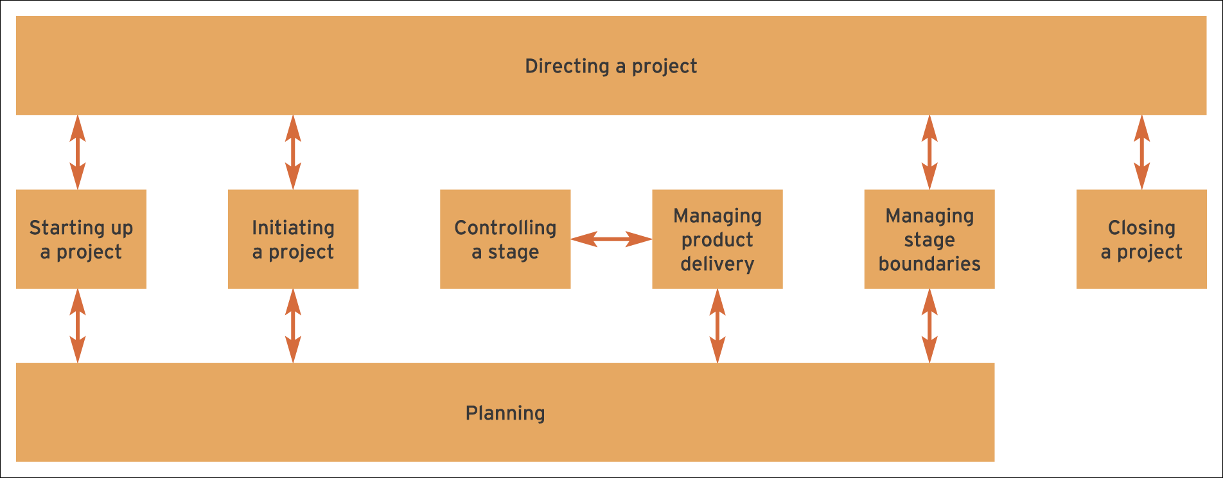
PRINCE2 Process Model
Figure 9.5 PRINCE2 Process Model

Slide 23
Network analysis
Critical path diagrams are used extensively during scheduling and monitoring to show the planned activities of a project and the dependencies between these activities.
Critical path: Activities on the critical path are
termed critical activities. Any delay in these activities will cause a delay in the project completion time.
Critical path method (CPM): Critical path diagrams show the relationship between activities in a project.

Slide 24
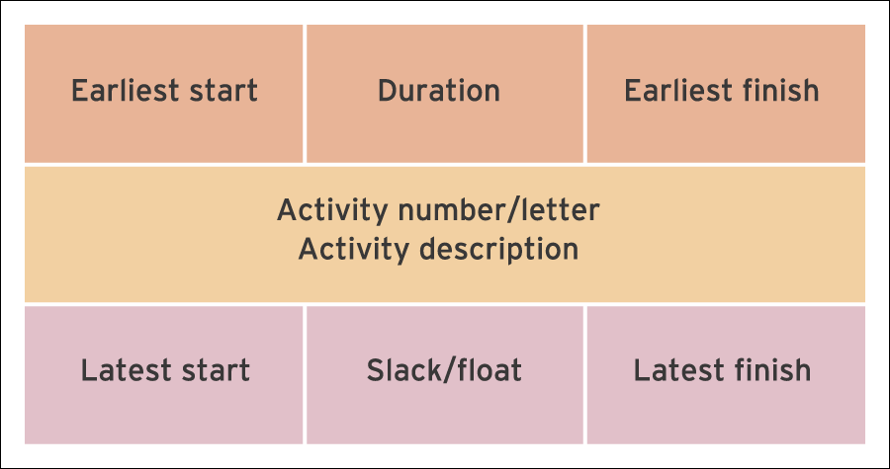
Figure 9.6 Activity on node notation

Slide 25
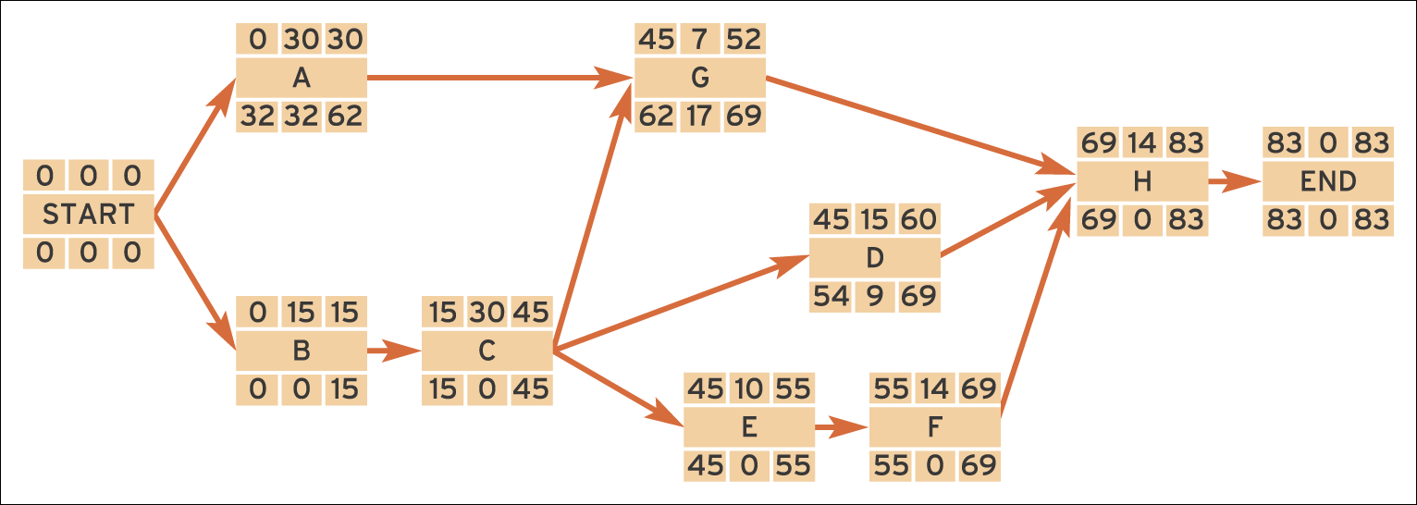
Figure 9.7 Activity on node network diagram

Slide 26
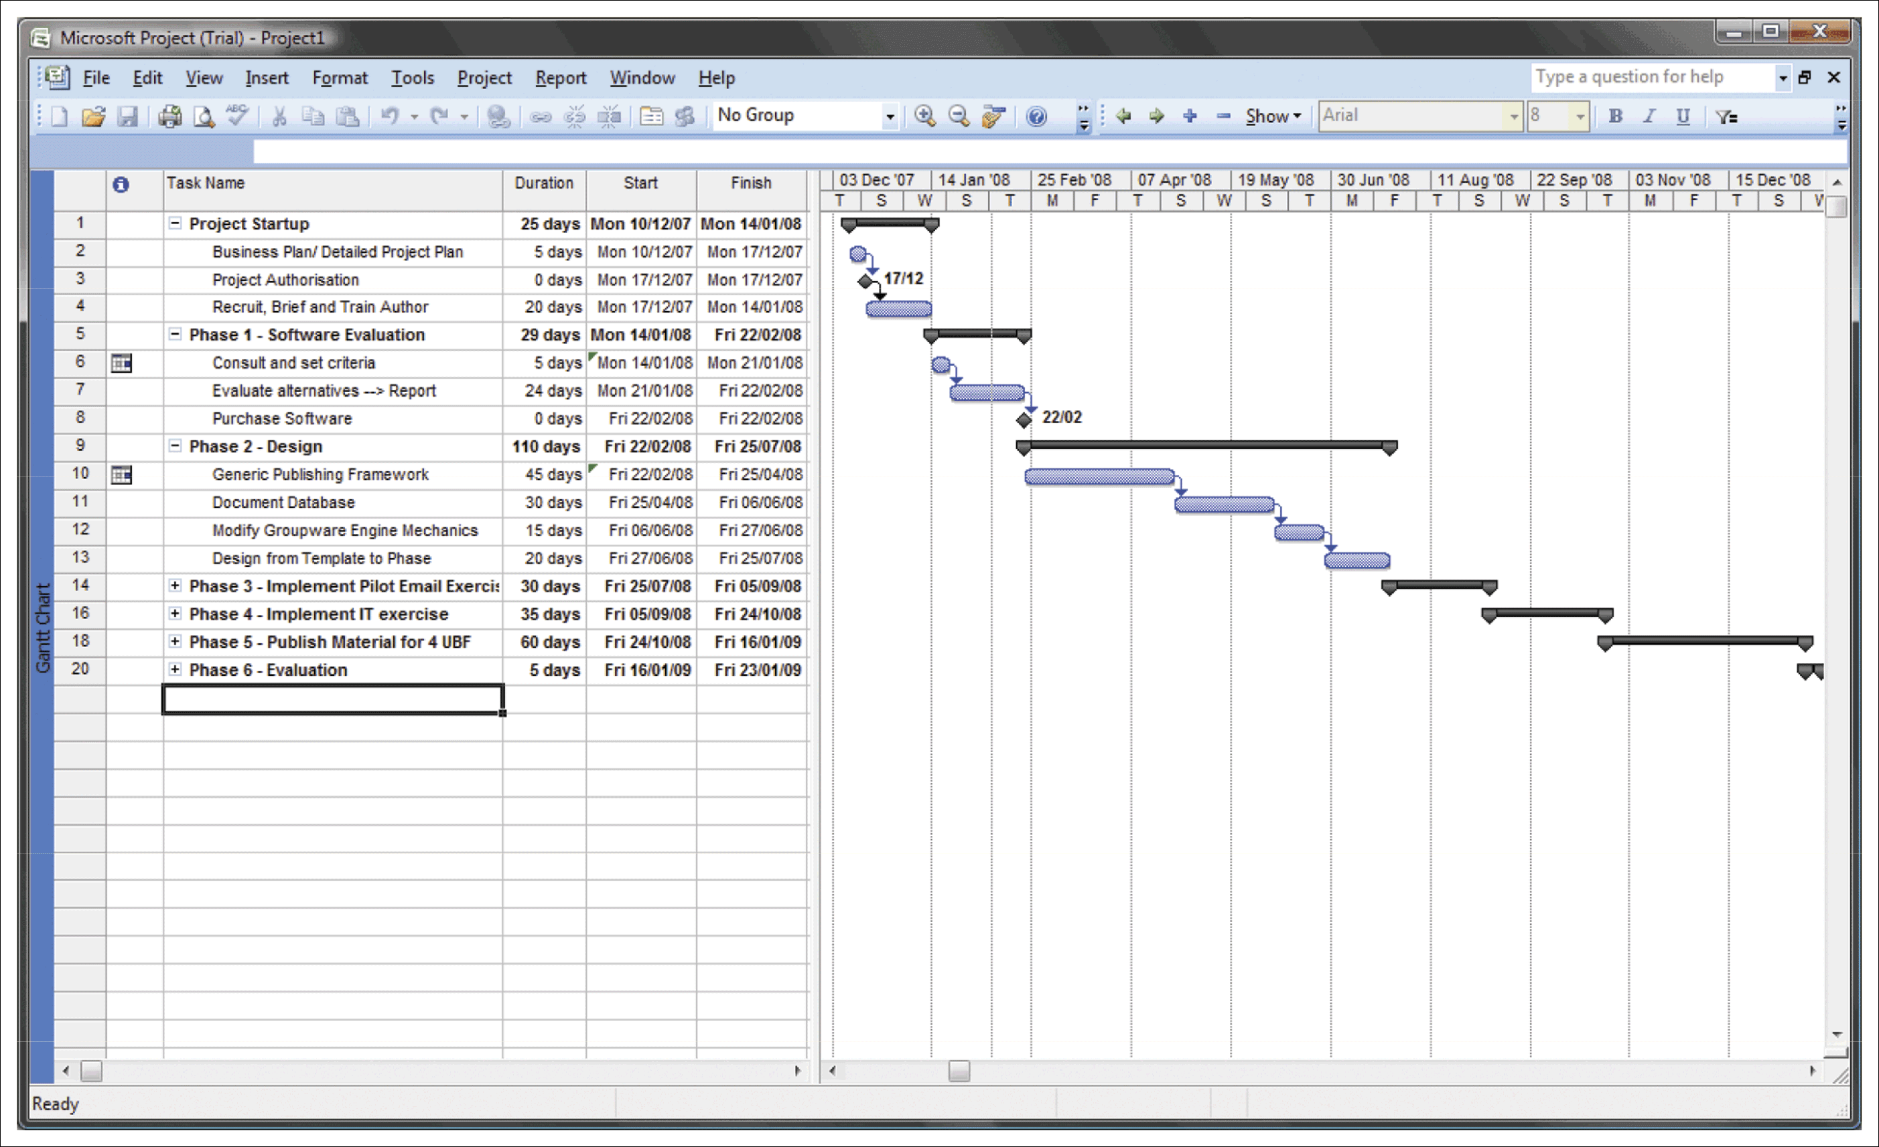
Figure 9.10 Gantt chart showing activities and milestones
Source: Screenshot frame reprinted by permission from Microsoft Corporation

Slide 27
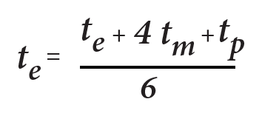
Project evaluation and review technique (PERT)
PERT: PERT replaces the fixed activity duration used in the CPM method with a statistical distribution which uses optimistic, pessimistic and most likely duration estimates.
Where t(e) is the Expected time, t(o) is the Optimistic time, t(m) is the most probable activity time and t(p) is the Pessimistic time.

